Slide 1
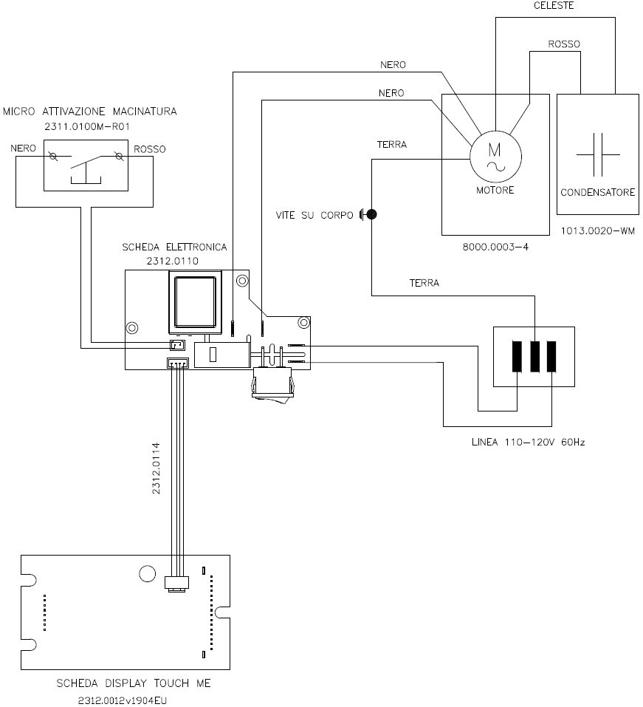
L – 110V power supply grinder wiring diagram

